Slide 1

EXPLORING THE TORONTO DATASET
Analyzing and Clustering the top Foursquare venues in the Toronto Area

Slide 2
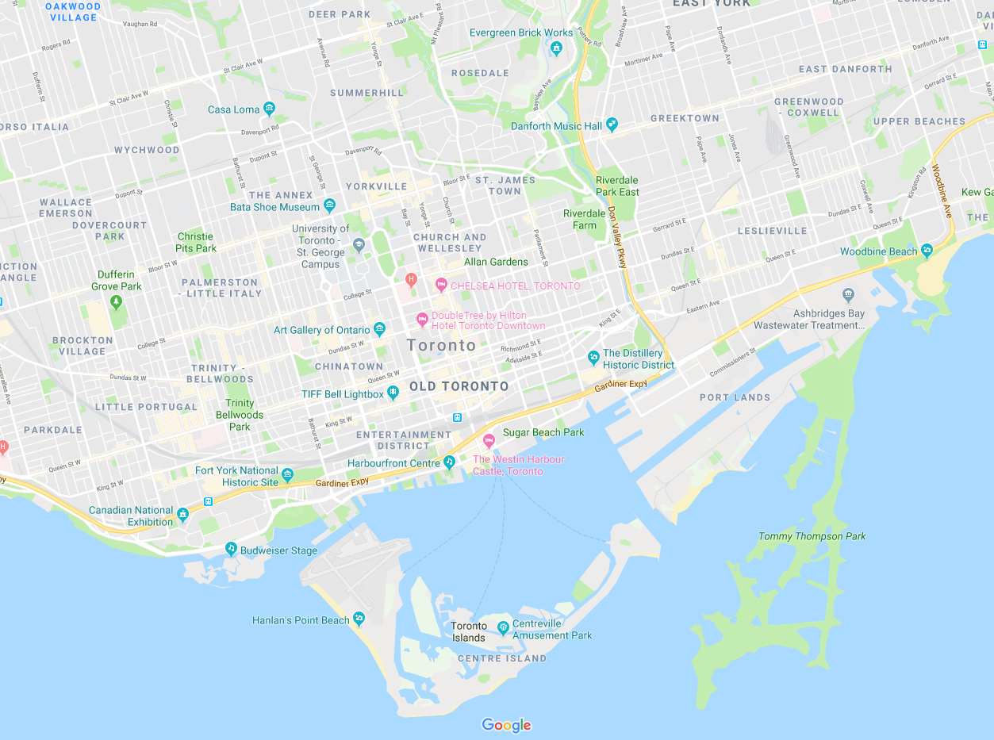
Project Steps:
Scrape the Web for data on Toronto Neighborhoods
Create, clean and finalize Data frame to plug into the Foursquare API
Get Location Data for our scraped data
Create our final Data frame with the pulled Foursquare data
Use Machine learning (Kmeans) to cluster and segment our data
Finally we can analyze our clusters to make an informed business decision!

Slide 3
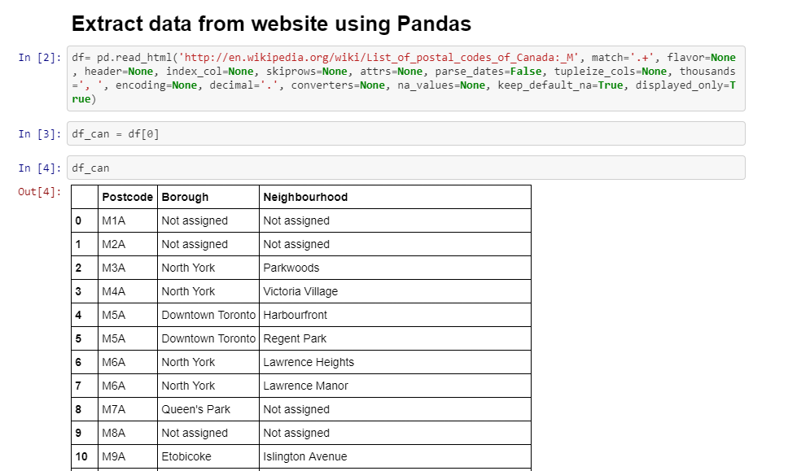
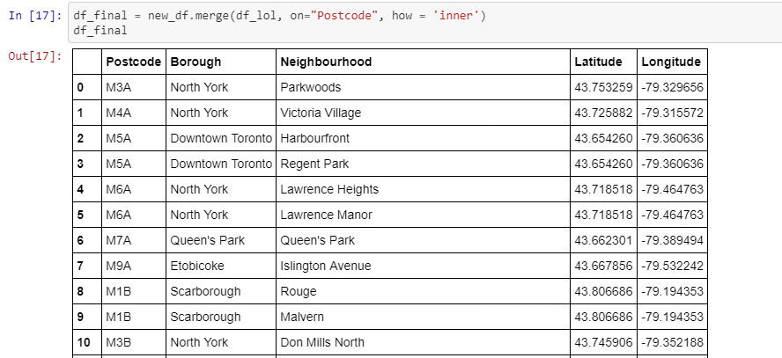
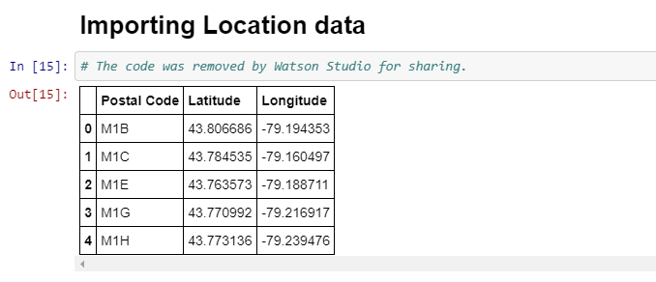
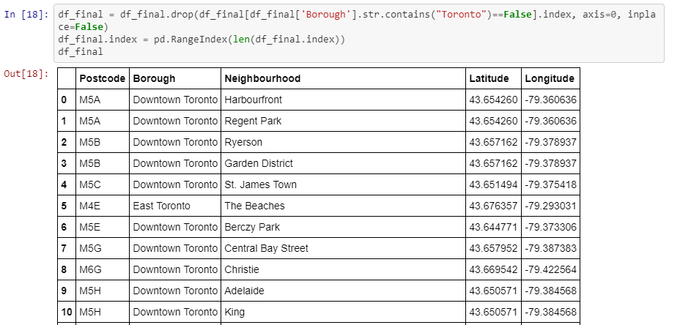

Slide 4
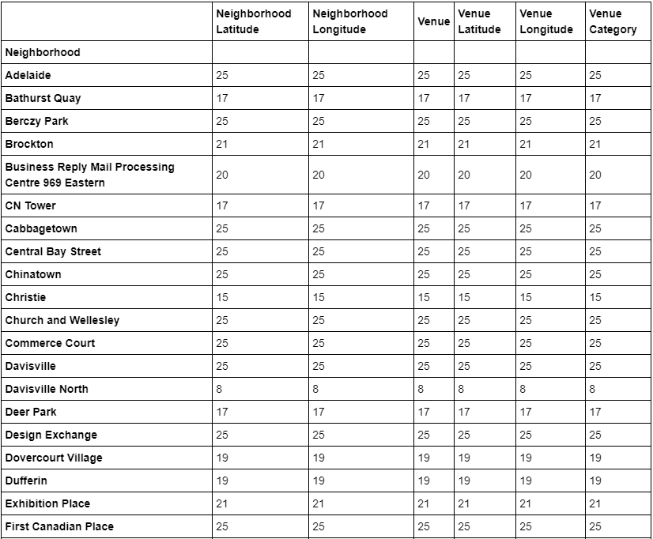
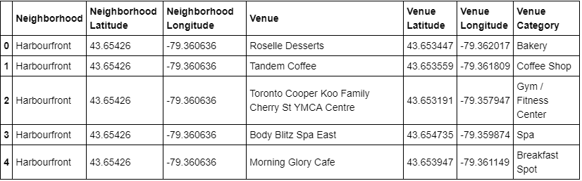
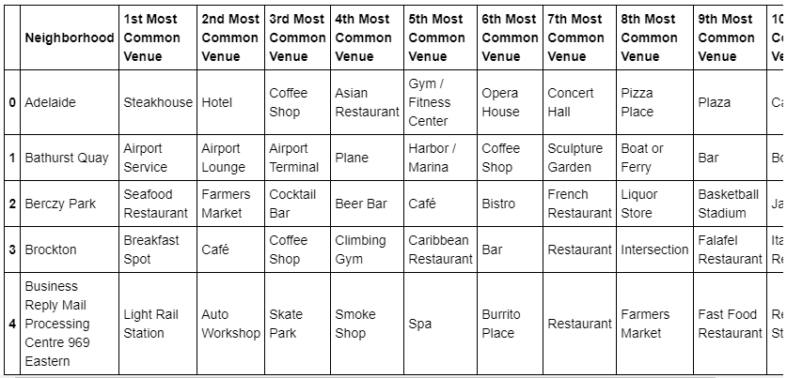

Slide 5
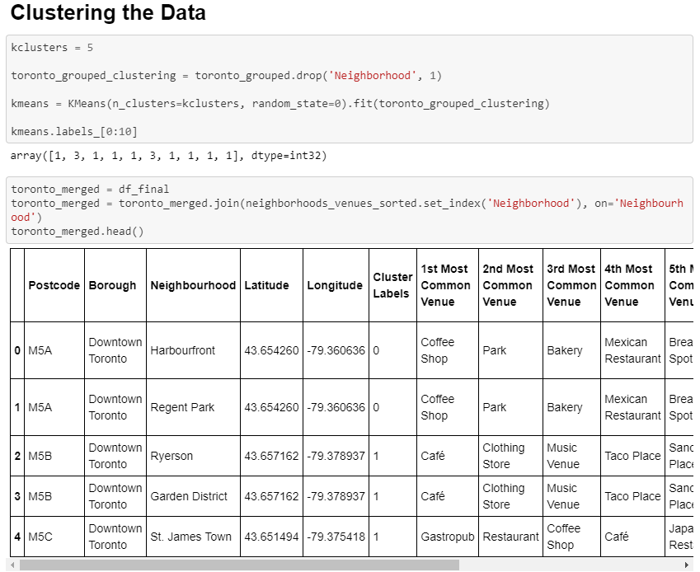
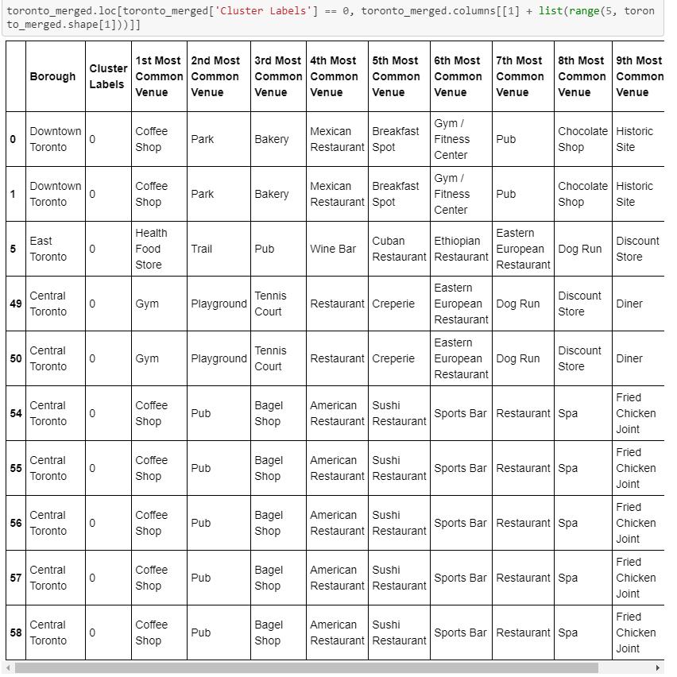
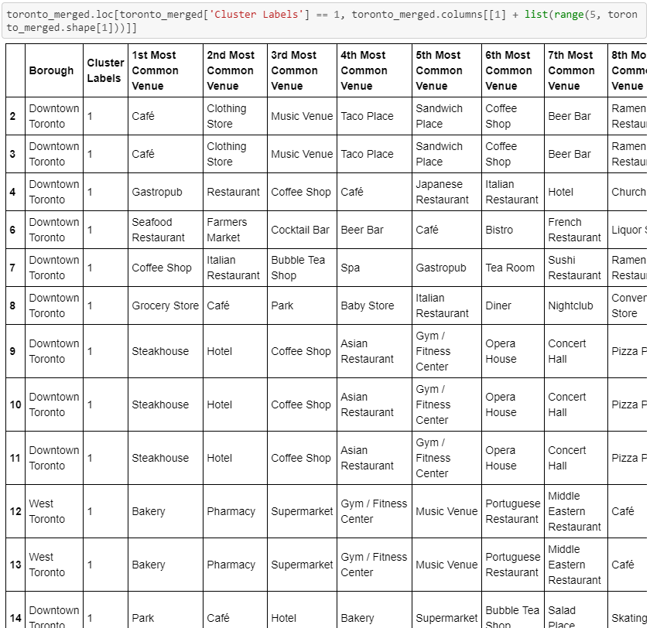
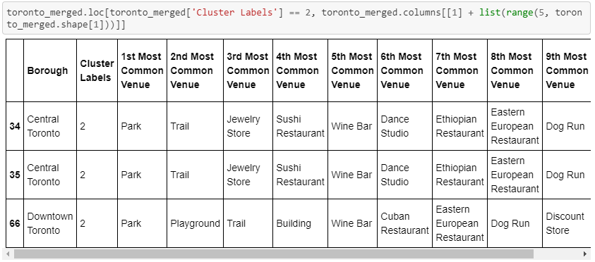

Slide 6
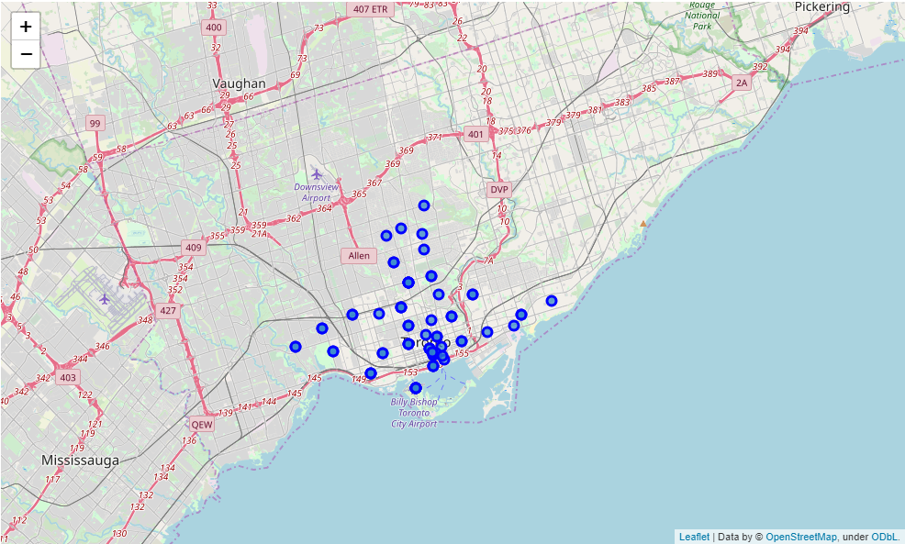
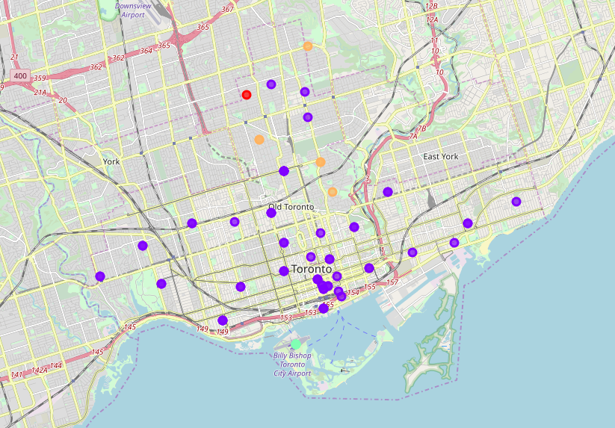

Slide 7
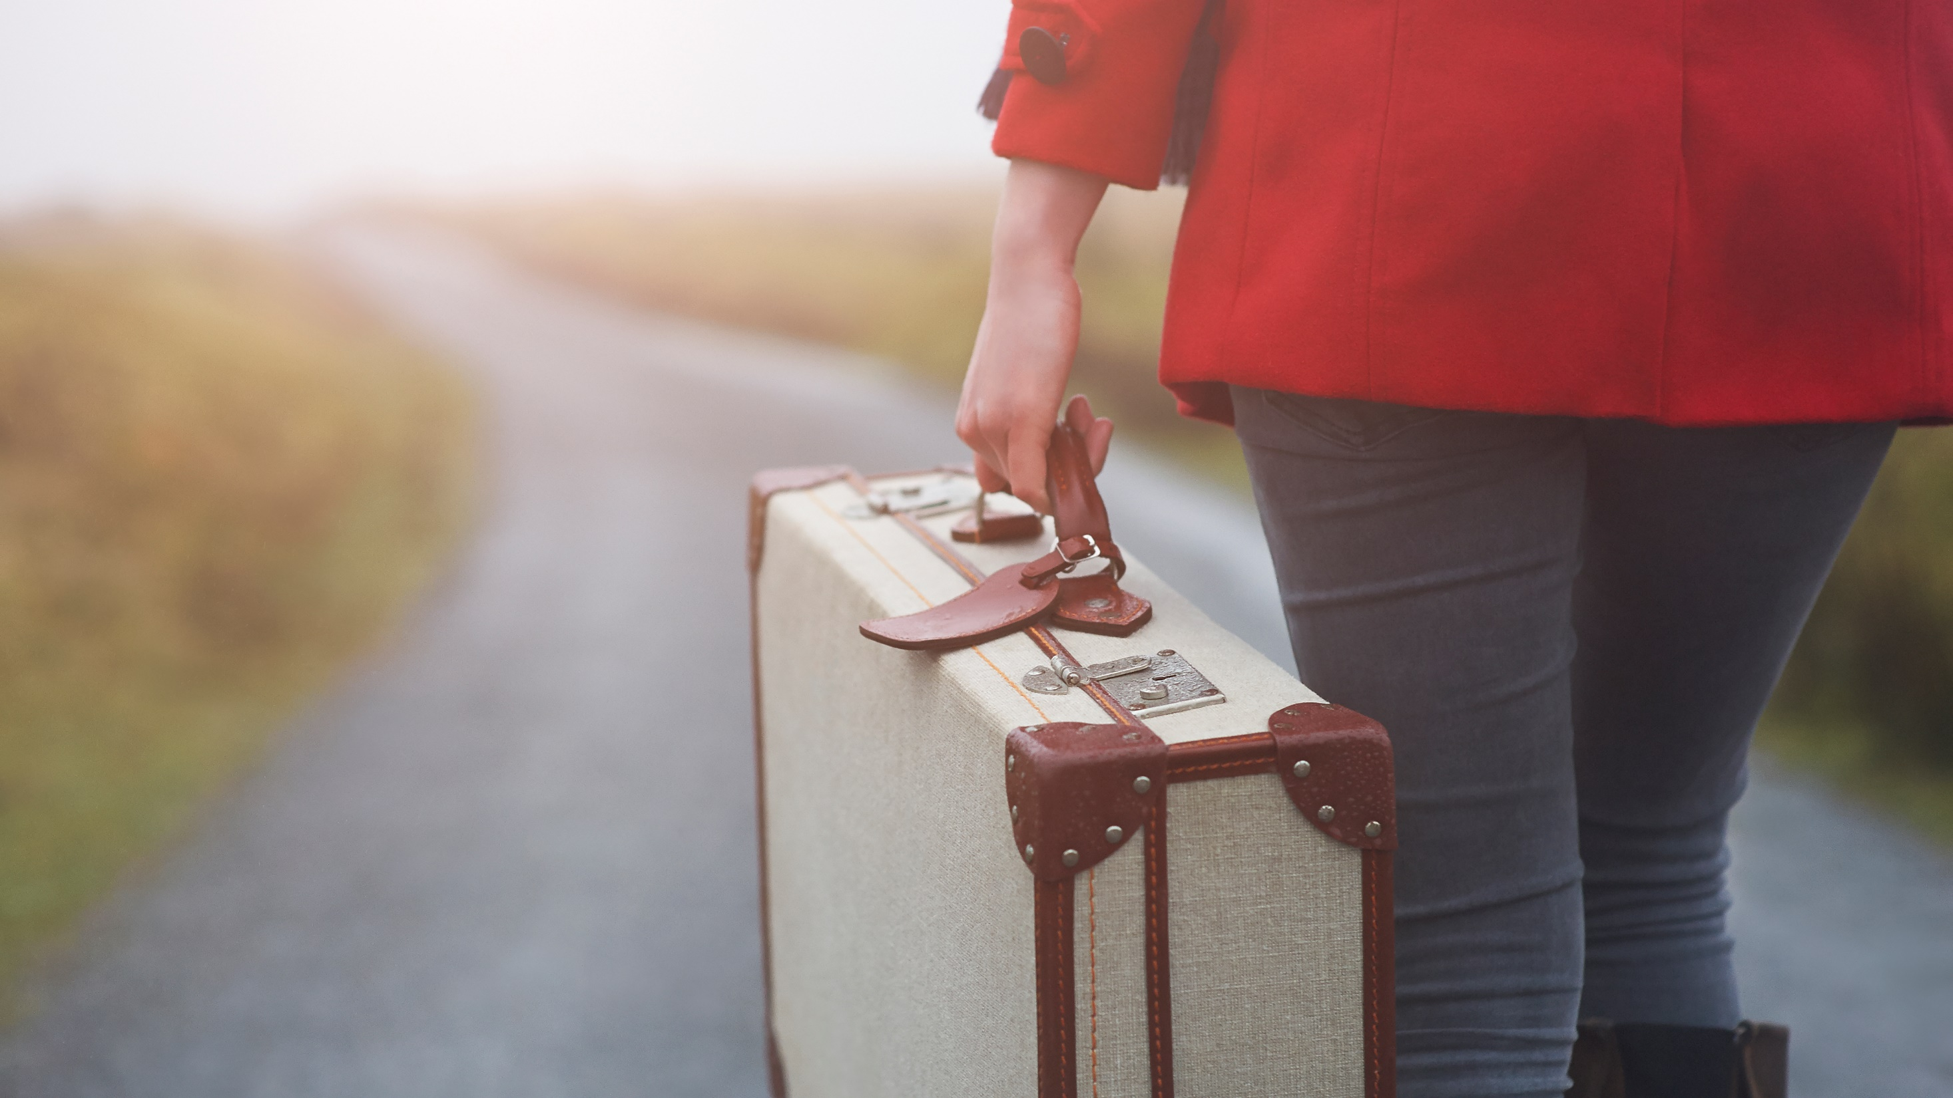
Thank you FOR TAKING THE TIME TO VIEW MY PROJECT!
Have a lovely day <3

